Slide 1
The Association of Canada Lands Surveyors
Tania Bigstone, CLS, PEILS _{(np)}
ACLS President &
Chair, Survey Cost Working Group

Slide 2
Association of Canada Lands Surveyors (ACLS)
The main purpose of the Survey Cost Study (from the ACLS perspective) was to:
validate or negate the statements and suggestions with regards to the cost of surveys on Canada Lands being more expensive than those on Provincial Lands
In response to the Report findings:
Is there more that the ACLS and it’s Members can or should be doing?

Slide 3
Data Collection/Gathering
Scope of Study:
Legal Surveys performed on lands under the instructions of the Surveyor General of Canada
Surveys for the purpose of defining parcels for land transactions, defining jurisdictional limits and maintaining exterior boundaries
NOT included:
Non-Canada Lands Surveys –
done under provincial statutes and regulations to support ATR’s, TLE, location surveys, technical surveys, IOGC surveys

Slide 4
Data Collection/Gathering
3 Parts to Data Collection:
Interviews with First Nations
“Survey Monkey” questionnaire 75 Responses
Telephone interviews 10 Interviews
Survey Research and Land Surveyor Interviews
Analysis of Sample CLS Projects 73 Sample Projects
Comparison of Surveys
Compare Part B surveys (where applicable) with Provincial Surveys (i.e. abutting or contiguous municipality) 11 Comparisons

Slide 5
Preliminary Results of PART A: (Interviews with First Nations)
Awarding of Survey Contracts
Preferred Surveyor
Price
Most First Nation’s (who responded):
manage the contracts
have their own internal form of record keeping
rely on funding from INAC for survey projects
Legal Surveys: one of the main types of surveys needed

Slide 6
Preliminary Results of PART A: (Interviews with First Nations)
“Performance Review”
Communication with Members
Majority of the communication:
First Nation & Surveyor
Showing the boundaries on the ground
Method of Delivery for Plan copies:
Electronic vs. Paper copy

Slide 7
Preliminary Results of PART B: (Interviews with ACLS Members)
Cost Drivers Identified:
∙Condition of evidence
∙Scope of Work
Condition of Boundary Evidence | Average Project Labour
Good | 86 hours
Fair | 82 hours
Poor | 170 hours
More Clarity =
∙Type of Survey
Jurisdictional Bdy. 359.9 hours
R/W 107.3 hours
Parcel 94.2 hours

Slide 8
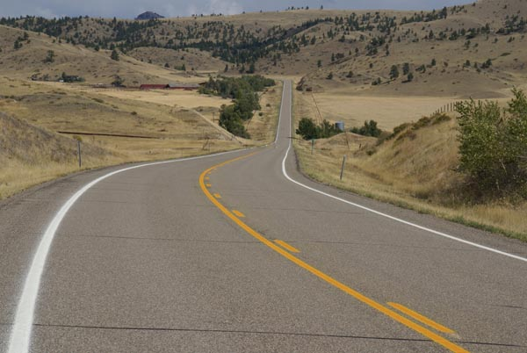
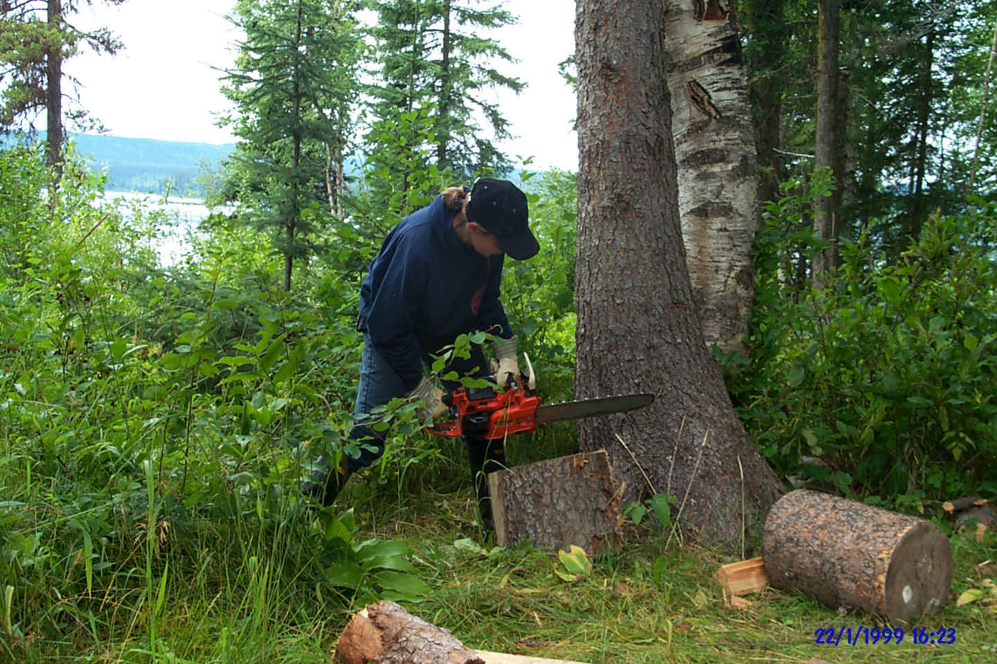
Preliminary Results of PART B: (Interviews with ACLS Members)
∙Distance Travelled
∙Line Cutting & Blazing
∙Drafting/CAD work ∙Quality Control ∙Georeferencing ∙Initial Contact

Slide 9
Preliminary Results of PART C: (Provincial vs. Federal Comparison)
Time by CLS vs. Provincial Surveyor
Distance travelled
Government Processes
Resolving conflicts between Cadastral evidence locations
Client meetings (on-site)
Labour
Evidence searches

Slide 10
Review & Comments of Study Results
Overall Comments:
More involvement by CLS in the project
Infrequent use of MyCLSS & Request for instructions
Surveyors – We want to get it right
Members are creating relationships
Always room for Improvement Communication
“Legal Surveys on First Nations Reserves generally cost less than comparable legal surveys in the provinces.”

Slide 11
Where do we go from here?
Committee
Work
Education
Awareness
Materials

Slide 12
Review & Comments of Study Results
Thank you!
First Nations
ACLS Members
INAC and NRCan
Survey Cost Working Group Members

