Slide 1
Land Use Planning Initiative
2017 National Surveyors Conference
March 3, 2017

Slide 2
Objective
Provide support to communities for the development of land use plans (lup) and associated surveys, and Indigenous organizations to ensure capacity in these areas is built or maintained.
Land use planning helps communities set goals about how it will grow and develop while keeping important social, economic and environmental concerns in mind.
Land surveys facilitate better land parcel management, where legal interests are clearly mapped, identified and registered to ultimately enhance clarity and certainty of all rights to lands.

Slide 3
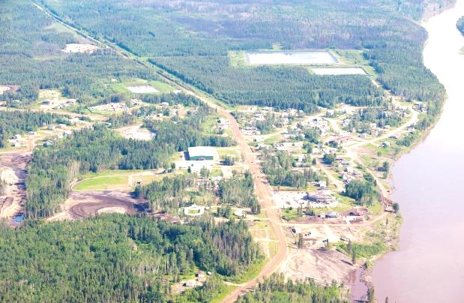
Why Invest in LUP?
To support and enhance First Nation community land and environmental management and to drive larger lands policy reform
To align with community infrastructure investments and support comprehensive community planning
To help resolve outstanding estate and boundary issues identified by the community to support land use plan implementation
To attract businesses and develop partnerships with neighbouring communities or industry
To streamline land management decision-making

Slide 4
LUP Impacts
LUP
Bylaws
Designations
Service Agreements
ATRs
Energy Needs
Parcel Fabric

Slide 5
Key Components of Initiative
LUP
Community-led
Guiding Principle
Institutional Support
Maps
Outcome: Greater control over lands and resources

Slide 6
2016-17 Investment Highlights
Land Use Plans
LUP Initiative: 43 communities
Surveys
60 survey / mapping projects
Wikwimekong pilot project
Institutional Support / Capacity Building
NALMA Coordinator and Training Delivery
Tulo Certificate
FNLM LUP Capacity Building: 10 communities

Slide 7
2017-18 Priorities
Internal Alignment
Comprehensive Community Planning
First Nation Infrastructure Investment Plans
New Entrants
Prioritization and selection
Capacity Building
Tulo Certificate Program on Land Planning and Surveying
Wikwemikong Pilot Project Expansion
NALMA Regional Associations Core Capacity
Environment: SARA, FNAdapt, etc.
Risk management

Slide 8
LUP Alignment Projects
Comprehensive Community Planning
LUP / CCP Pilot
Economies of scale
Build on existing capacity
ENVIRONMENT
ECDEV
L
ENERGY
EMERGENCY
LUP / FNIIP Pilot
-How to integrate 10-year plan in LUP process
-Opt-in policy
U
P
First Nation Infrastructure Investment Plan

Slide 9
Batchewana LUP - Background
5Ws of LUP
What is LUP?
Why is LUP important?
Who is responsible?
Where should it apply?
When is it required?

Slide 10
Batchewana LUP - Process
Pre-Planning Phase
Development Phase
Implementation Phase
Monitoring Phase
LUP Team & Lands Manager
C&C
LUP Team & Lands Manager
LUP Team & Lands Manager
LUP Team & Lands Manager
C&C
C&C
C&C
FN Community
FN Community
FN Community
FN Community
Implement
LUP
Ongoing monitoring/ evaluation
Goals defined
& research completed
LUP drafted & approved

Slide 11
Batchewana LUP - Map

Slide 12
Batchewana LUP - Implementation Structure
Community Membership
Chief and Council
- Provide input and direction
- Approve major milestones
External Resources (e.g. NALMA, INAC)
- Provide support
Community Planning Team
- Facilitate process
- Gather information
- Prepare recommendation
Community Advisors (e.g. Elders)
- Provide input /advice and build consensus
Internal Resources (e.g. Admin)
- Provide input

Slide 13
Batchewana LUP - Challenges / Opportunities
Challenges
Communications, engagement, conflict in visions, Chief & Council buy-in
Lessons learned
What works and what can be improved
Opportunities
How can we work better with surveyors to improve land use planning process?

Slide 14
Discussion Questions
What are some of the implementation opportunities or challenges you foresee?
What role do you see for Canada Land Surveyors in supporting Indigenous communities with their land use plans (and related surveys)?
Do you have any questions, comments or concerns?

Slide 15
LUP - Building Sustainable Communities
Annex A
From | To
Multiple visions | Shared community vision developed through meaningful membership consultation
Haphazard and slow development | Planned and efficient incremental community development
Limited information for decision-making | Detailed inventory of lands, existing infrastructure and environmental considerations
Lengthy and fragmented land transactions | Coordinated land transactions that respond to the speed of business
Infrastructure built on or near contaminated / environmentally sensitive areas | Properly situated infrastructure that is environmentally sustainable
Vulnerable communities | Reduced impact by designing climate resilient communities
Working in isolation | Improved relationships and opportunities with neighboring jurisdictions and industry

